Slide 1
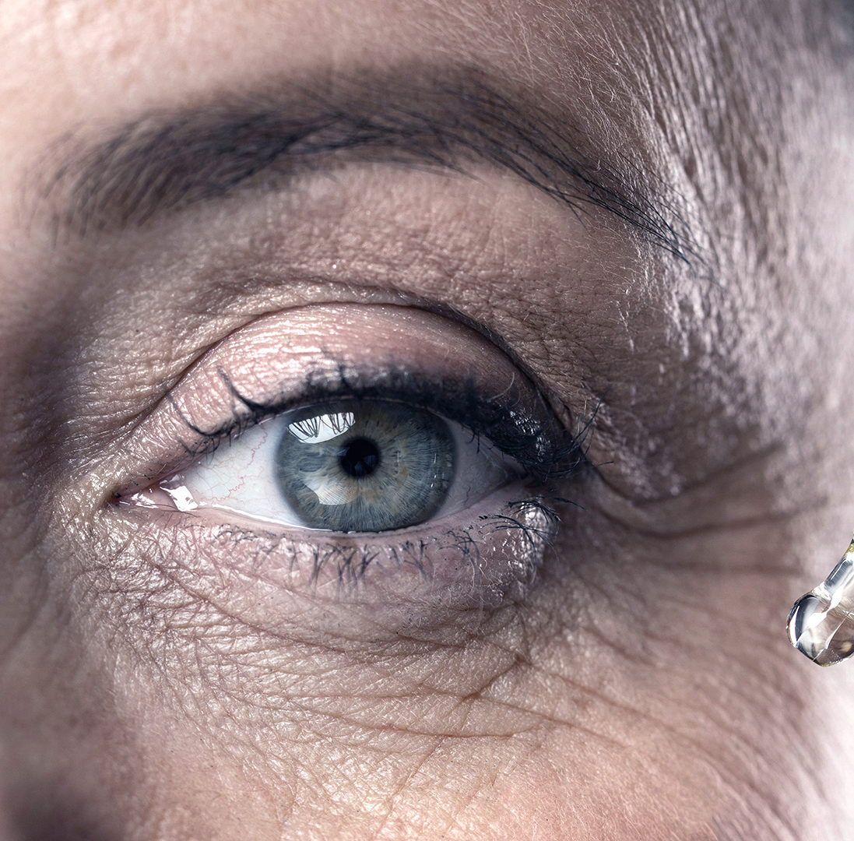
Eye Care Clinic
COMP2332
E-care

Slide 2


This case study is going to identify an Eye Clinic organizational business processes/services
Introduction :
Which medical center?
Dr. Mahmoud Bisher Clinic.
Which service/part of it?
St John Eye Hospital.

Slide 3
Table Of Contents
Description
The EPC model
Aris Model
The AS-IS BPMN model
Analysis of the AS-IS
Proposed changes to the AS-IS model: including resolved problems or made improvements
To-BE BPMN, showing the resolved and made process improvements.

Slide 4
Case study Description:
Ophthalmology is a branch of medicine and surgery which deals with the diagnosis and treatment of eye disorders. An ophthalmologist is a specialist in ophthalmology. Ophthalmologists are allowed to use medications to treat eye diseases, implement laser therapy, and perform surgery when needed. Ophthalmologists may participate in academic research on the diagnosis and treatment for eye disorders.
Although most people may think that eye doctors do nothing but deal with appointments of people needing glasses and contacts, they actually do a whole lot more. Even general eye evaluations entail examining the health of the eye and looking for any potential concerns. Take for example, someone needing contacts for the first time; in addition to the evaluation, the doctor will need to provide additional services. This can include training on how to insert and remove contacts and providing general care information as well as diagnosing and solving any fit problems. They also need to know which type of contacts would be best for their patient as there are many varieties, including multifocal, soft disposable, keratoconus, rigid gas permeable, monovision and irregular-shaped lenses for individuals with corneas that have suffered disease or surgery.

Slide 5
When the patient visits the clinic for an eye exam, the patient has to reserve an appointment first, after the patient arrives at the clinic, they will pay the fees at the reception before they go to the doctor’s office. If the patient has medical and/or vision coverage, the receptionist will check their plan documents to see if these additional exams and tests are covered, If not the patient will pays in cash. Then the receptionist will check if it’s the patient’s first time or if it’s a follow up, if it’s their first time a record will be created for the patient, after that the patient will stay at the waiting room until the doctor calls them in. At the beginning of the eye exam, the eye doctor will ask for the patient’s medical history, if they have been experiencing any vision problems and the reason of the visit. If they currently have glasses or contacts, they should bring them to the exam so the eye doctor can see if they need prescription changes, and then the doctor will redirect the patient to optical to get the prescribed lenses.
Case study Description:

Slide 6
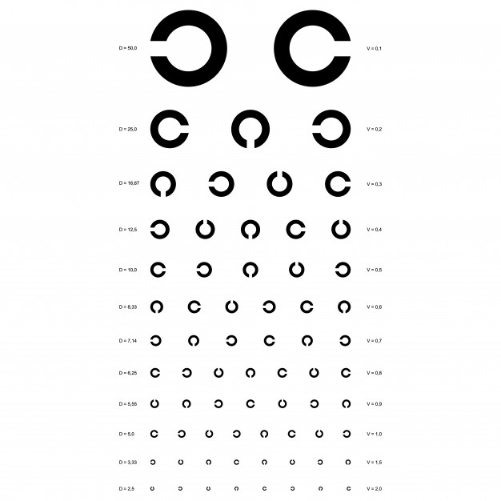
During the eye exam, the eye doctor can perform a number of different tests such as a visual acuity test which examines how well you can see with each eye. The doctor may ask the patient to cover one eye at a time while identifying symbols. Typically, these symbols are different sized letters or numbers on a chart that’s displayed at a distance from the patient. Based on the results, the doctor can determine how well the patient can see at a distance.
Case study Description:

Slide 7
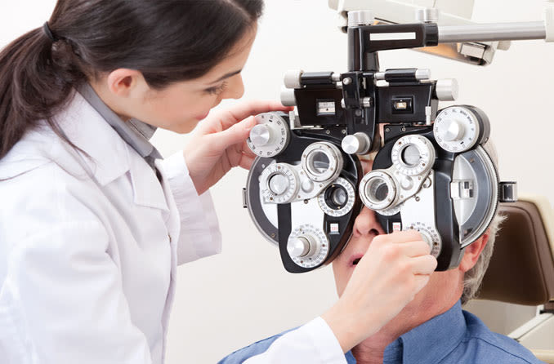
The doctor may also perform a refraction eye exam which helps the doctor figure out what prescription is needed for glasses or contact lenses. To test this, the doctor may have the patient look into a machine that displays lenses of different strengths. By switching the lens in front of each eye while they read letters and numbers on a chart, the doctor can figure out which lens is best for them. This refraction test also helps the doctor to determine if the patient need a different strength lens in each eye. Doctor will check the patient’s results and give a diagnosis, further tests may be done if needed.
Case study Description:

Slide 8
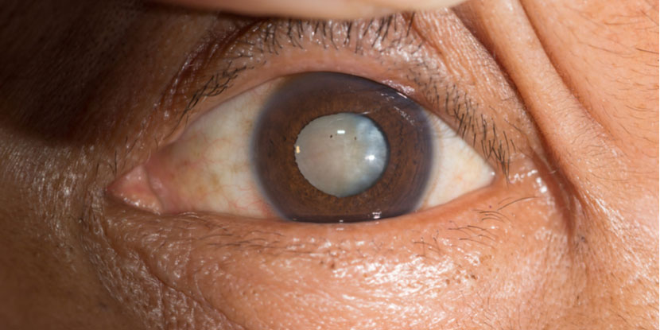
If the doctor finds any problems during a comprehensive eye exam (a series of routine vision tests), they may ask the patient to come back for a follow-up eye exam so they can run additional vision tests. This is often done once a year or once every two years. In some cases, like optic neuritis (when the optic nerve becomes inflamed) or in case of cataract (an opacification of the lens of the eye which leads to a decrease in vision) the doctor will redirect the patient to the hospital for further treatment After the diagnosis is done, the patient will leave the doctor office.
Case study Description:

Slide 9
Introduction :
Improving the flow of patients through the clinic is about making their journey easier while making the best use of the doctor’s time and the resources in the eye clinic. It can be done by eliminating unnecessary steps and processes, giving more time to focus on patients and on providing a good – and friendly -service. Here are some of the stations the patient goes through on his journey and the time taken at each station (we too the average time for 7 patients).
• Time the receptionist takes to check the patient’s insurance:
For a new patient: 7:24 mins (including the time taken to create their profile).
Already exists patient: 5:14 mins
• Retrieval of medical records (the doctor asking about the patient’s medical history and the reason of the visit): 2:13 mins
• Treatment: 7-10 mins

Slide 10
We also asked the doctor some questions to help us understand what causes inefficiencies in the process, and to understand where most problems occur to find prober solutions for them.
• How many patients are seen on a daily basis? 10-15
• How many patients are early or late for appointments? 3-5
• How many patients do not show up for appointments? 1-2
• How long do patients have to wait in the clinic for appointment delays? Approximately 15-30 mins
• Does gathering patient information add to appointment delays? Yes, sometimes.
• Do you allow time in your days for emergency appointments? No didn’t consider it.
• Are there certain days of the week when bottlenecks occur more often? Sat, thu, sun
• At what days do most emergency cases occur? Usually after the weekends end so on Sundays & Saturdays.

Slide 11

The EPC Model
The EPC Model

Slide 12
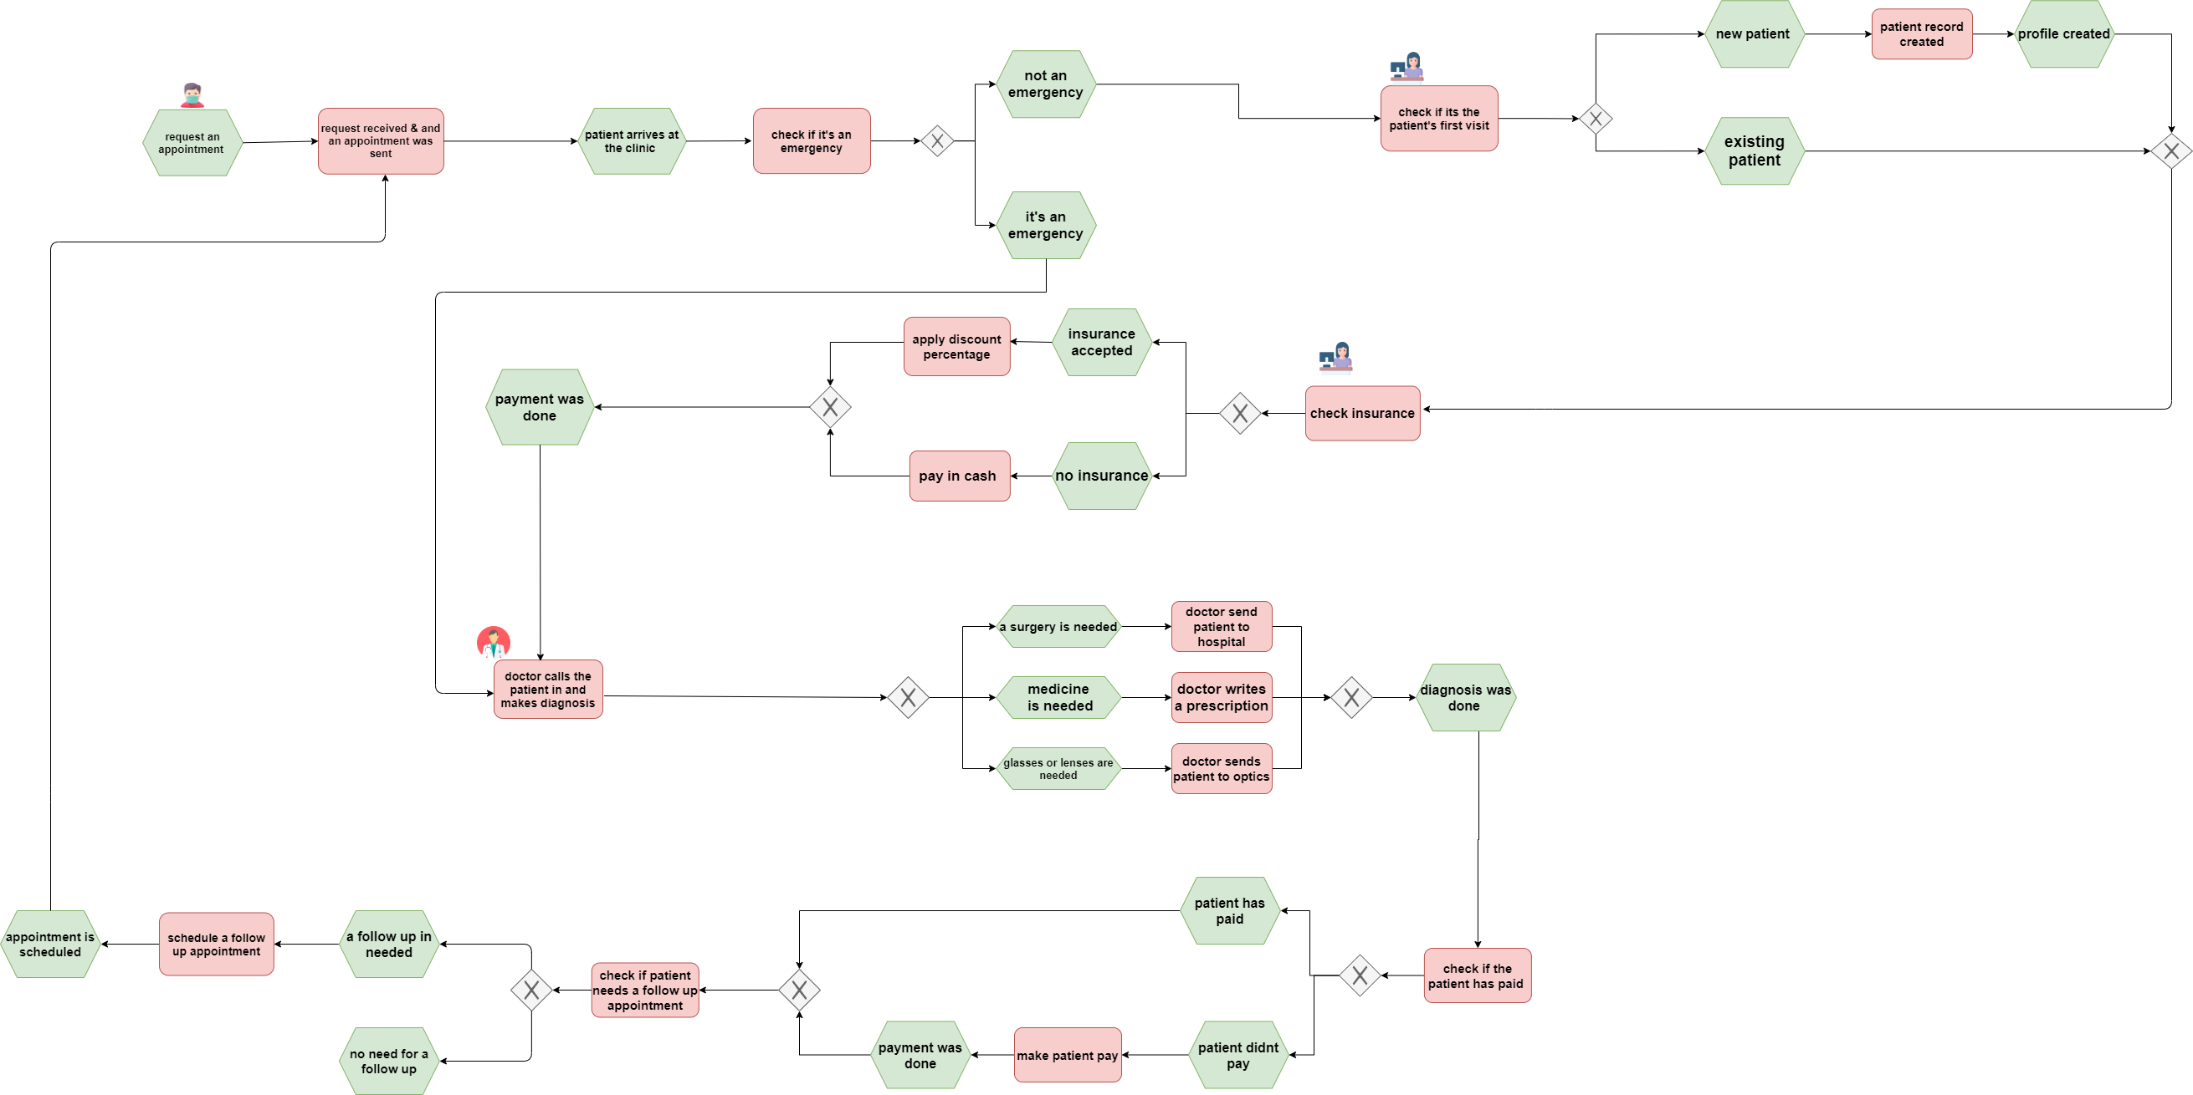

Slide 13

The ARIS Model

Slide 14
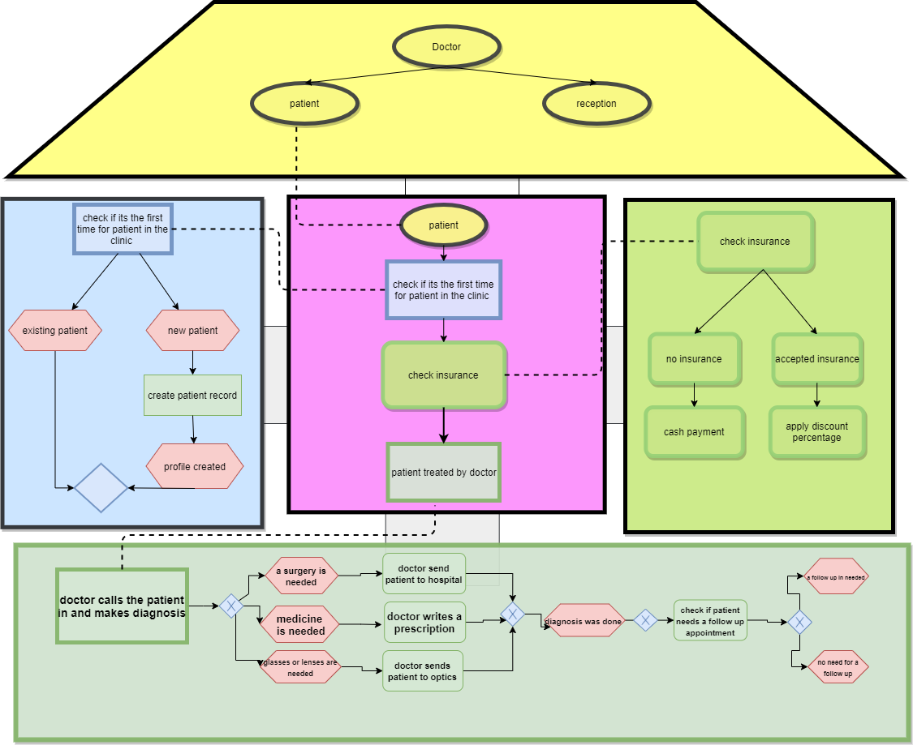

Slide 15
The AS-IS BPMN model

Slide 16
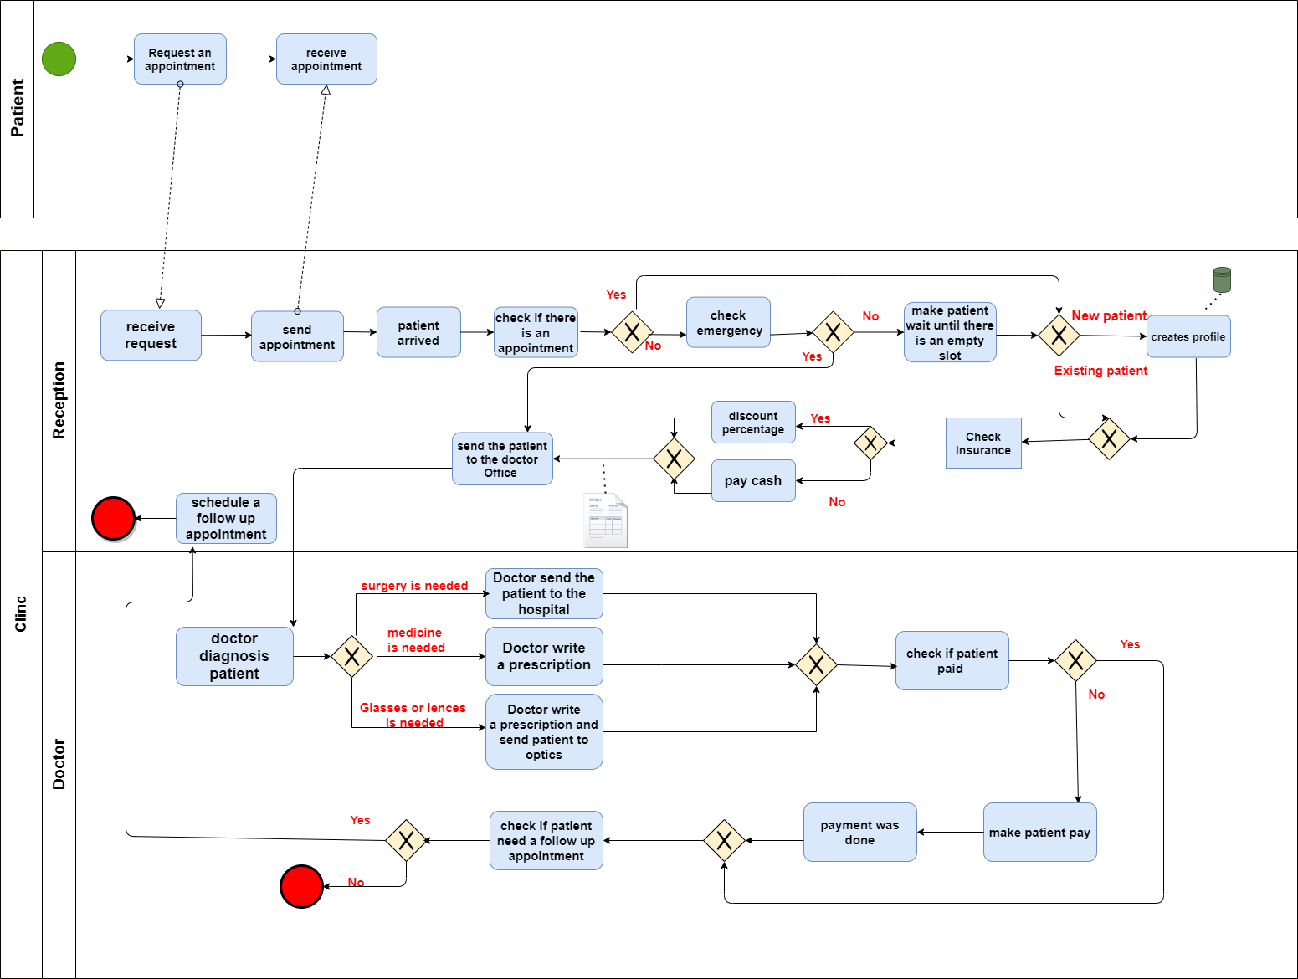

Slide 17
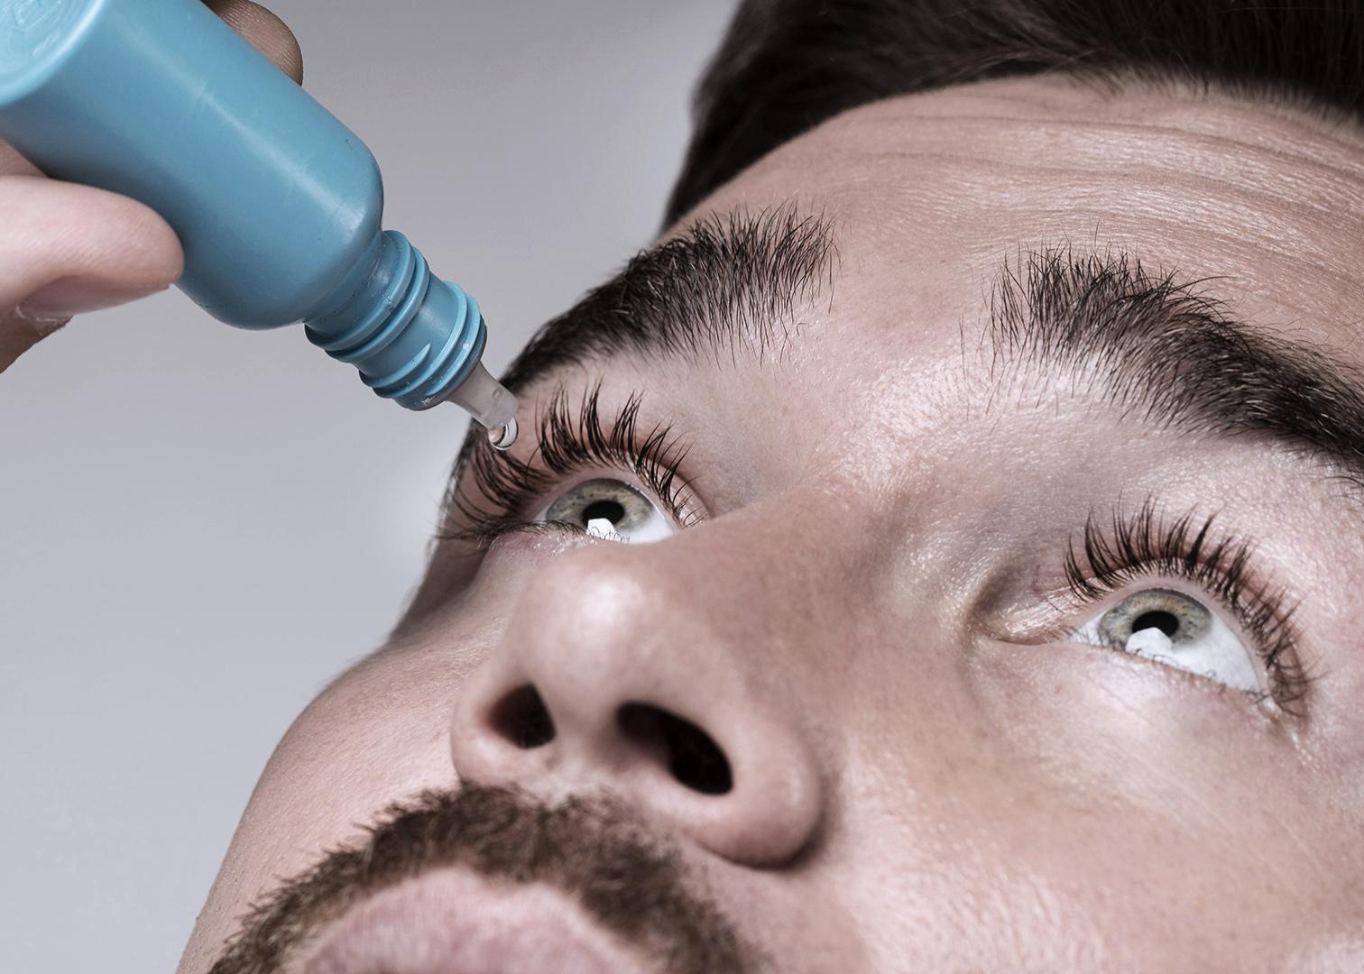

Analysis of the AS-IS Primary (core) activities, support and management activities.

Slide 18
Primary (core) activities
• The doctor examining the patient and giving diagnosis.
• Receptionist checking if the patient has paid.

Slide 19
Support activities
01
The Secretary scheduling patients’ appointments.
Secretary handling Payments and checking the patient's health insurance.
Secretary handling calls and messages.
Secretary checking if the patient has a prescheduled appointment and if it’s an emergency case.
02
03
04

Slide 20
Management activities
The manager is the doctor:
• Employee recruitment.
• Checking and handling clinic incomes.

Slide 21


Business process inefficiencies in the primary activities, and possible errors or unnecessary support activities , and if any inefficiencies in management activities.

Slide 22
Using excel to store patients information and appointments is unsafe, since anyone can change the info and access the data, and the data could be deleted anytime.
Checking in process takes a very long time
absence of the receptionist or the doctor

Slide 23
Some days or times of day are busier than others, which could potentially increase delays and get the clinic behind schedule

Slide 24
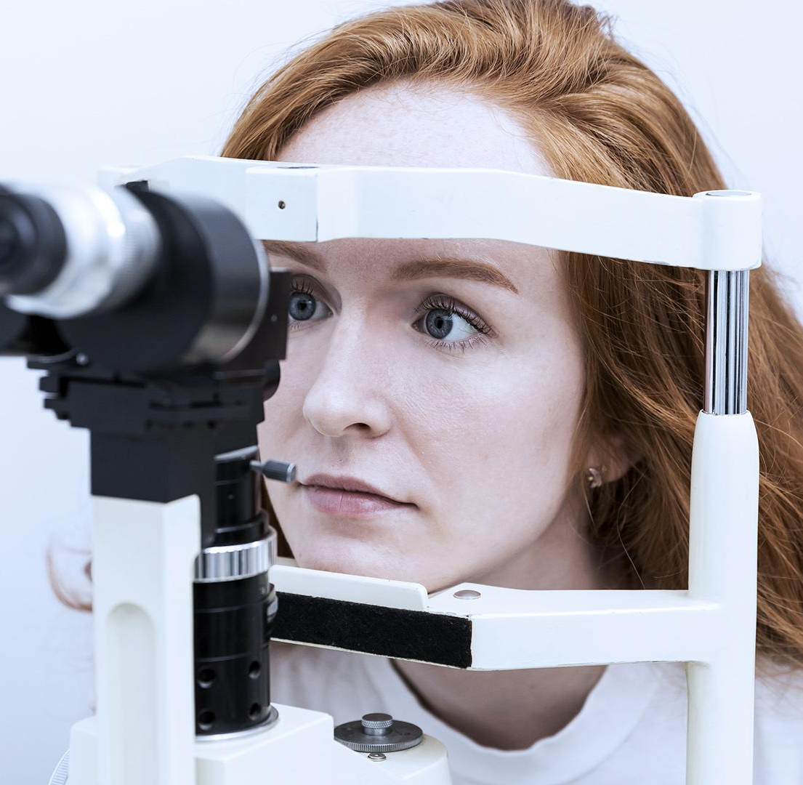
Actual causes, causing inefficiencies in activities.

Slide 25
the receptionist takes the patient information when they arrive at the clinic. Which could probably cause delays or make other patients late for their appointments. And it puts the receptionist under a lot of stress.
Clinic getting behind schedule because of poor appointment scheduling and management.
The clinic is not prepared to deal with emergency cases or patients with no reserved appointments, the way they dealt with this problem was by calling all patients to tell them about the delay which is cost and time inefficient.

Slide 26

Analyse the AS-IS model using what-if scenarios.

Slide 27

A question that the process would ask is , What if a large number of patients arrived and the number of patients that the doctor can treat was only 10-15 ? This can cause all of the pressure on the doctor and maybe there won’t be enough time to treat or give medical attention to all of them.
Another scenario , What if the patient is late to their appointment or didn’t show up?
What if Patient comes with no appointment? This could cause a possible delay in other patients’ appointments and get the clinic behind schedule.
What if doctor absent ?
What if patient wants to cancel their appointment ?
Canceled appointments are missed healthcare utilized time slots and resources that can negatively affect the utilization of space and human resources.

Slide 28
The To-be model

Slide 29
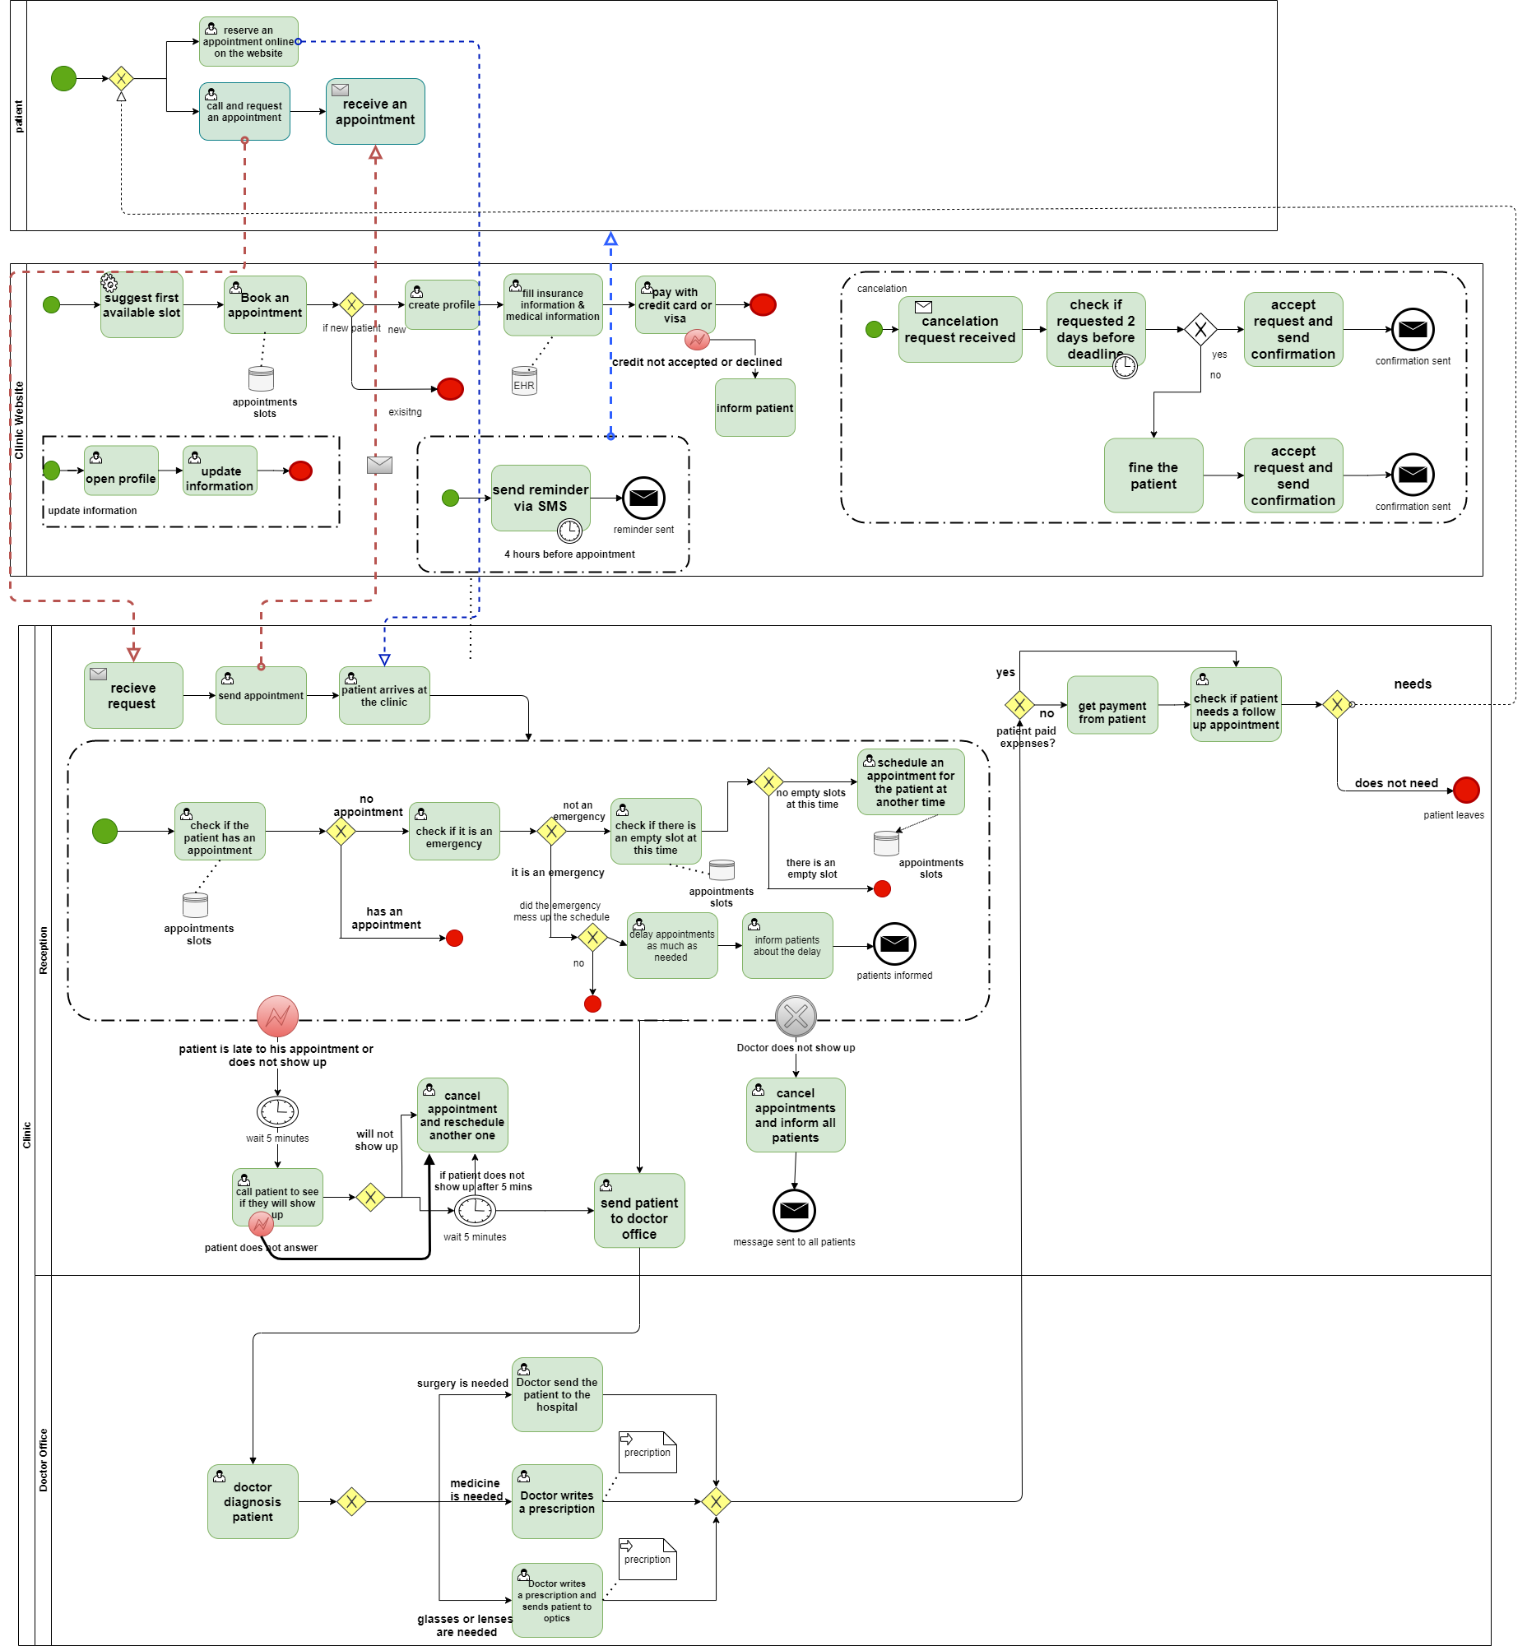

Slide 30

3.2 how the new TO-BE model addresses the identified inefficiencies?

Slide 31
Major cause of bottlenecks, the patient check-in processes influence the efficiency of the patient flow. Before even seeing the doc, patients may arrive late or get held up filling out forms with front office staff. So, when a patient calls to schedule an appointment, the secretary will verify their insurance information over the phone instead of when they check in to their visit. Or a better solution is to use a secure online portal where patients can fill out required forms ahead of time. forms will be simple and focused to help patients complete them quicker. Forms will include questions about the patient’s medical history and general information, it will also include a precise description of the directions to the clinic’s address, this will cut down on new patients arriving late or not arriving at all because they got lost trying to find the clinic. After seeing the doctor, patients may need to schedule a follow up visit, diagnostic testing, and/or be referred to another doctor or the hospital for special care. Simplifying these processes not only frees up staff time and facilitates necessary care, it enables patients to check in easier and leave quicker. Using a different counter to check patients out so they don’t have to wait on patients checking in. When a follow up or referral visit has been recommended, patients can go to the clinic’s page or software to schedule the appointment in an empty spot and choose the reason of the appointment. When the patient arrives at the clinic, the receptionist will check if they paid their bill, if they didn’t they will have to pay before seeing the doctor. The receptionist will then check if the patient has a reserved appointment, if they don’t, the receptionist will send them to the doctor office only if it’s an emergency. if not, the receptionist will check if there are no appointments scheduled at the time of their arrival, so if there is an empty slot the patient will be sent to the doctor’s office, but if there was no empty slots the receptionist will schedule an appointment for another time and will inform the patient, or the patient can schedule one themselves using the clinic website. If the patient does not show up or is late for their appointment, the receptionist will wait 5 minutes before calling them to make sure if they will be coming or not, if not their appointment will be canceled and will be scheduled for another time. If they will be coming, they have another 5 minutes if they do not show up their appointment will be canceled and will be scheduled for another time. When the patient arrives at the doctor’s office, the doctor will do some tests and give a diagnosis, and if a surgery is needed the patient will be sent to the hospital, if medicine is needed the doctor will give a prescription. Then if a follow up is needed another appointment will be scheduled.

Slide 32
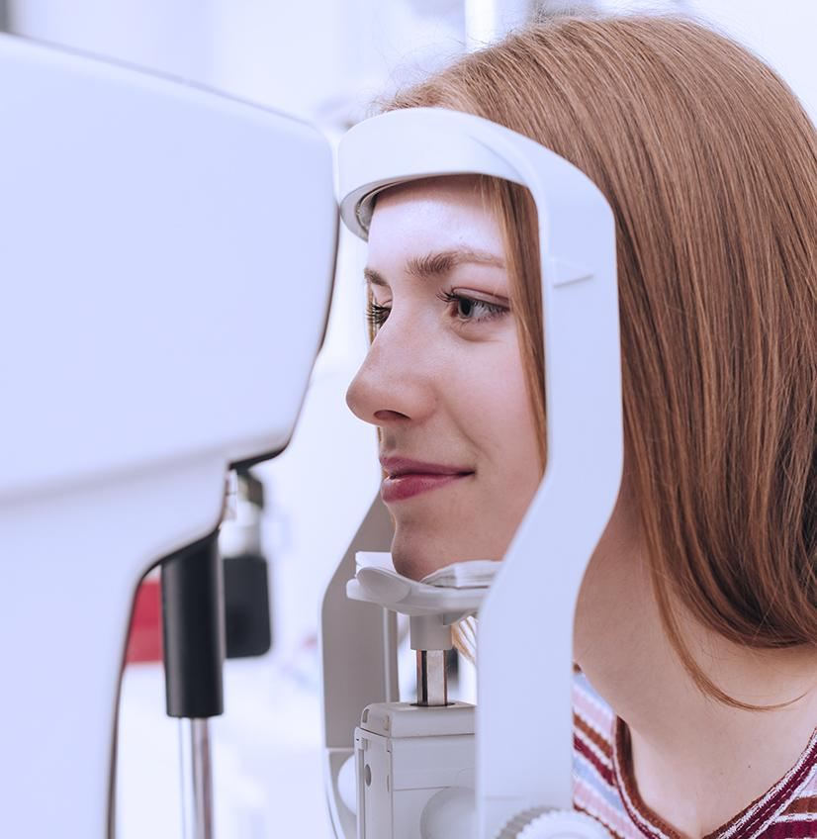
3.3 Analyse the “TO-BE” model, using the scalability of the model testing using what-if scenarios.

Slide 33
What if a large number of patients arrived and the number of patients that the doctor can treat was only 10-15 ?
Solution: the time slots on the website are distributed or allocated in a way that fits the doctor’s ability to see or treat patients in a day, so if the number of patients exceeds the maximum number of patients he could see in a day the patient can’t really schedule an appointment or see the doctor in this day and will have to reschedule to another time.

Slide 34
What if the patient is late to their appointment or didn’t show up?
This will cause a delay for all the other patients and will get the clinic behind schedule, it is also cost and time ineffective to call the all the patients and inform them about the delay or the possible cancellation of their appointments, which will leave the patient frustrated or unsatisfied. Solution: a message will be sent to patients 2 hours before their appointment to remind them, and if the patient is more than 5 minutes late to their appointment the receptionist will call the patient to see if they will still make it to the clinic, if not their appointment will be canceled and rescheduled for another time, if they will they have 5 more minutes if they don’t show up same thing will happen as mentioned before. And if the patient doesn’t answer the call the appointment will be also canceled and rescheduled.

Slide 35
What if Patient comes with no appointment?
Solution: if it’s an emergency , and it messes up the clinic's schedule then the receptionist will delay appointments and send all patients a message informing them about the delay, then the patient will be sent to the doctor, otherwise the receptionist will look for empty slots at the time of his arrival if there are any, the patient will be sent to the doctor’s office, if not an appointment will schedule for another time.
What if doctor absent ?
This will miss up the schedule and leave patients unsatisfied. Solution: patients will be notified before their appointments via SMS so they won’t come to the clinic for nothing, and all appointments will be canceled and rescheduled for another appropriate time.

Slide 36
What if patient wants to cancel their appointment ?
they have 2 days to cancel their appointment before the deadline. After that they will be fined.

Slide 37






Group Members :
Lana Elayyan Dania Alqam Bisan Goul Razan Yaseen Raneem Mansour Yazan Issa
1180839 1180950 1181116 1182226 1181706 1183066

